Slide 1
Multiprocessor
Characteristics of Multiprocessor
Interconnection Structures
Inter Processor Arbitration
Inter Processor Communication and Synchronization
Cache Coherence

Slide 2
Multiprocessor Characteristics of Multi-Processor (MP)
A MP is an interconnection of two or more CPU’s with memory and I/O equipment.
MP is MIMD.
Similarities between MP and Multicomputer (connected through network) systems
both support concurrent operations.
Difference between MP and Multicomputer
MP system is controlled by one operating system.
MP improves the reliability of the system

Slide 3
Contd..
MP system improves system performance by doing one of the two ways.
Multiple independent jobs to operate in parallel.
Single job can be partitioned into multiple tasks.
MPs are classified by the way memory is organized:
shared memory or Tightly coupled MP.
Tolerate a higher degree of interaction between tasks
distributed-memory or loosely coupled
Efficient when the interaction between tasks is minimal

Slide 4
Interconnection Structures
The components that form a MP system are CPUs, IOPs connected to I/O devices, and a memory unit that may be partitioned into a number of separate modules.
The interconnection between the component can have different physical configurations.
Some of these schemes are given as:
Time-shared common bus
Multiport memory
Crossbar switch
Multistage switching network
Hypercube system

Slide 5
Time shared Bus
Simplest form
Structure and interface similar to single processor system
Memory access is fairly uniform but not very scalable
Restricted to one transfer at a time.
So the total overall transfer rate within the system is limited by the speed of the single path

Slide 6
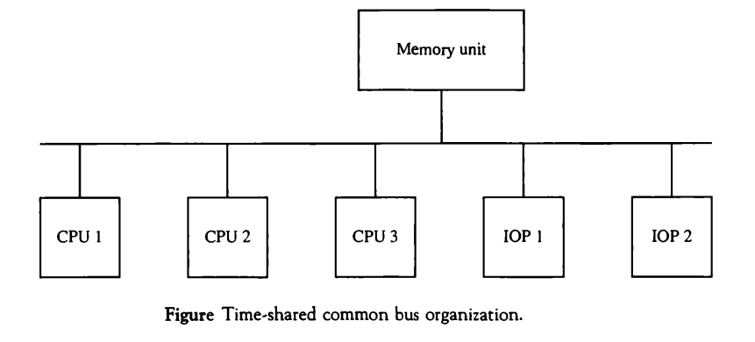
Contd..

Slide 7
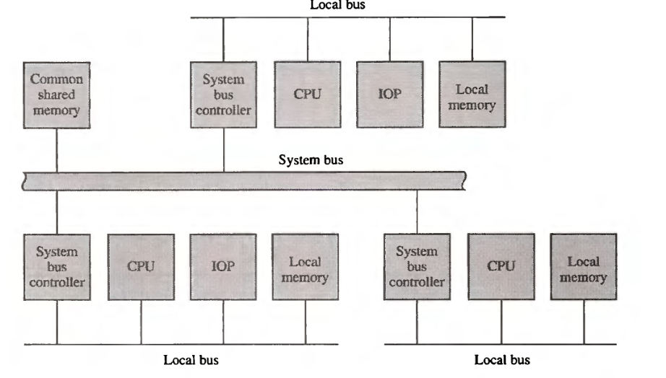
Contd.. (dual bus structure)

Slide 8
Multiport
Multiport memory module
Each port serves a CPU
Memory Module Control Logic
Each memory module has control logic
Resolve memory module conflicts
Fixed priority among CPUs

Slide 9
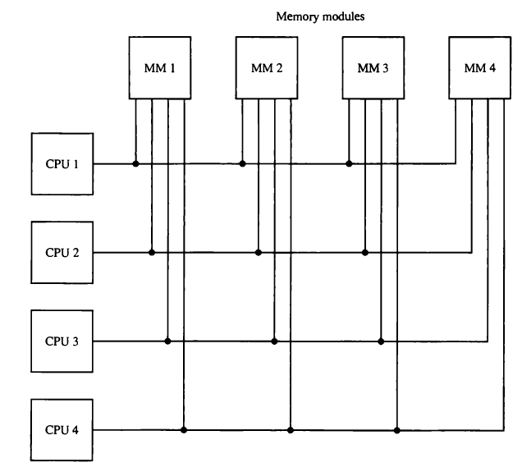
Multiport

Slide 10
Contd..
Advantage:
High transfer rate due to multiple paths
Disadvantage:
Requires expensive memory control logic
Requires large number of cables and connectors

Slide 11
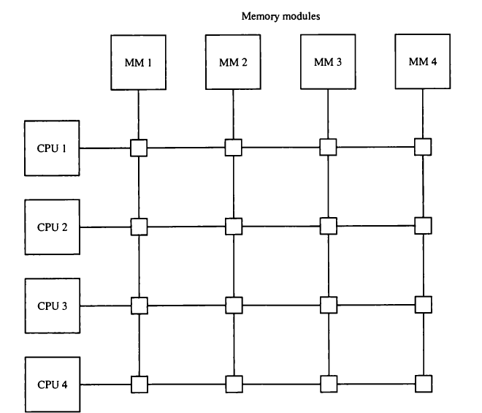
Crossbar switch

Slide 12
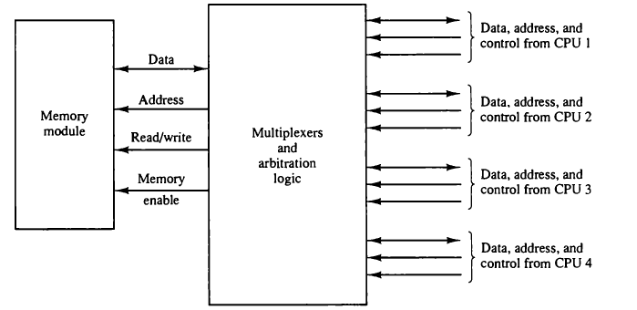
Contd..

Slide 13
Contd..
Advantage:
Supports simultaneous transfers from all memory modules
Disadvantage:
Hardware require to implement the switch can be complex and quite large

Slide 14
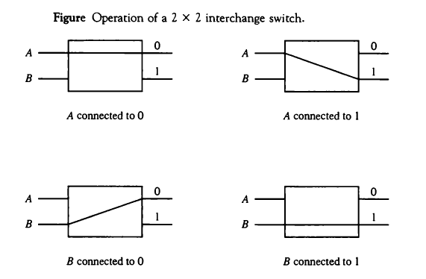
Multistage Switching Network

Slide 15
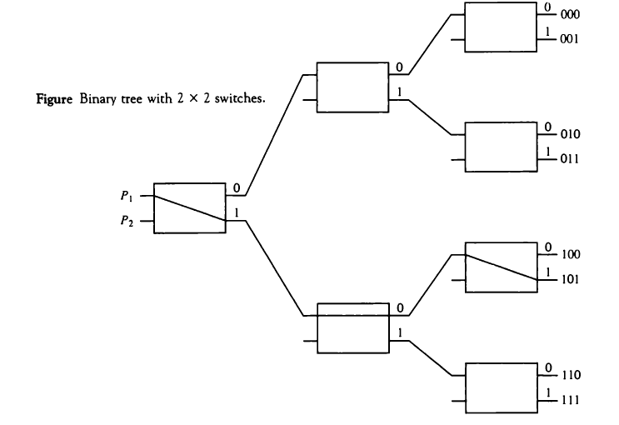
Contd..

Slide 16
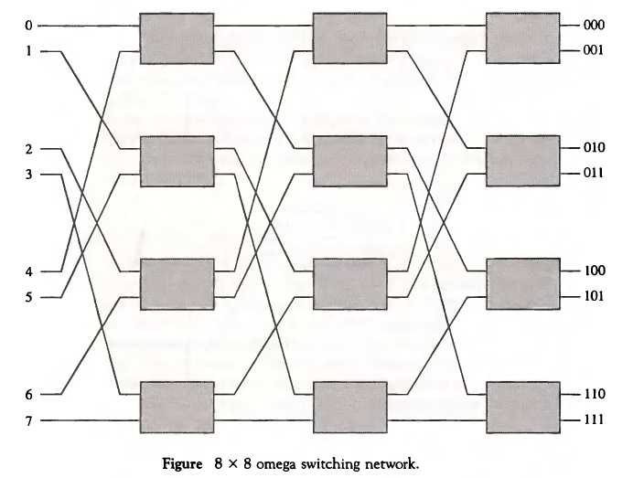
Contd..

Slide 17
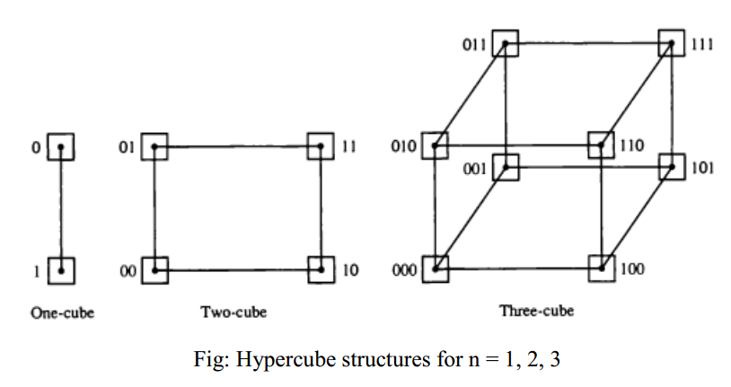
Hypercube structures (n-cube multiprocessor) useful for loosely coupled system

Slide 18
Contd..
Advantage
Hypercube networks reduce network latency by increasing the degree of each node (i.e., connecting each of the N nodes to log2N neighbors).
Disadvantage
The number of nodes should always be a power of two.

Slide 19
Inter-processor Arbitration
While the processors in a shared memory multiprocessor system made a request to access common memory or other common resources through the system bus then,
First condition: If no other processor is currently utilizing the bus, the requesting processor may be granted access immediately else, the requesting processor must wait.
Second condition: If more than one processors request the system bus at the same time, then arbitration must be performed to resolve this multiple contention for the shared resources. The arbitration logic would be part of the system bus controller placed between the local bus and the system bus.

Slide 20
System bus
Synchronous bus
Each data item is transferred during a time slice known in advance to both source and destination units.
Synchronization is achieved by either driving both units from a common clock
source or having separate clocks of approximately the same frequency in each unit.
Synchronization signals are transmitted periodically in order to keep all clocks in the system in step with each other.
Asynchronous bus
Each data item being transferred is accompanied by handshaking control signals to indicate when the data are transferred from the source and received by the destination.

Slide 21
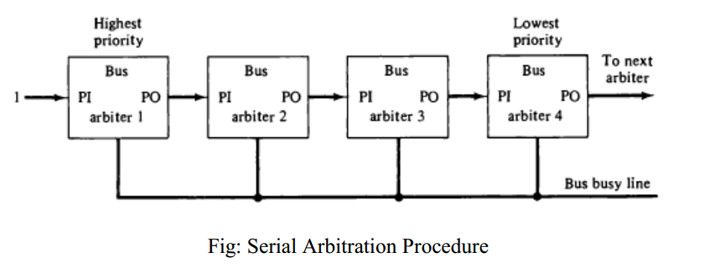
Serial Arbitration Procedure (daisy-chain arbitration)

Slide 22
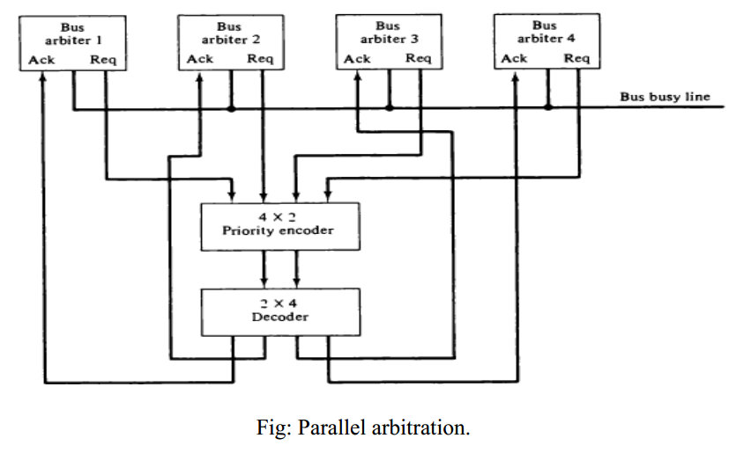
Parallel arbitration

Slide 23
Dynamic Arbitration Algorithms
Time slice
Polling
LRU
FIFO
Rotating daisy-chain

Slide 24
Inter-processor Communication
Shared memory multiprocessor system
Each processor can leave messages in a common global memory for other processors and pick up messages intended for it.
Status bits are used to indicate the condition of the shared memory
The receiving processor can check the common memory periodically to determine if there are valid messages for it.
A communication path between two CPUs can be established through a link between two IOPs associated with two different CPUs allowing each CPU
messages is transferred through this I/O path.

Slide 25
Contd..
To prevent conflicting use of shared resources by several processors there must be a provision for assigning resources to processors which is handle by the operating system.
Design of operating system for multiprocessors:
master-slave configuration
separate operating system, and
Distributed operating system.

Slide 26
contd..
In loosely coupled multiprocessor system
No shared global memory hence the communication between processors is by means of message passing through I/O channels.
The operating system determines the communication path for communication.
The communication efficiency depends on the communication routing protocol, processor speed, data link speed, and the topology of the network.

Slide 27
Inter-processor synchronization
Synchronization ensures the correct sequences processes and mutually exclusive access to shared written data.

Slide 28
Mutual Exclusion with a Semaphore
Mutual Exclusion
One processor to exclude or lock out access to shared resource by other processors when it is in a Critical Section
Critical Section
A program sequence that, once begun, must complete execution before another processor accesses the same shared resource
Semaphore
A binary variable
1:
A processor is executing a critical section, that not available to other processors
0:
Available to any requesting processor
Software controlled Flag that is stored in memory that all processors can be access

Slide 29
Cache Coherence
The same information may reside in a number of copies in some caches and main memory.
To ensure the ability of the system to execute memory operations correctly, the multiple copies must be kept identical.
This requirement imposes a cache coherence problem which means different values for the content of an address are in the cache and the main memory.
A memory scheme is coherent if the value returned on a load instruction is always the value given by the latest store instruction with the same address.
Without a proper solution to the cache coherence problem, caching cannot be used in bus-oriented multiprocessors with two or more processors.

Slide 30
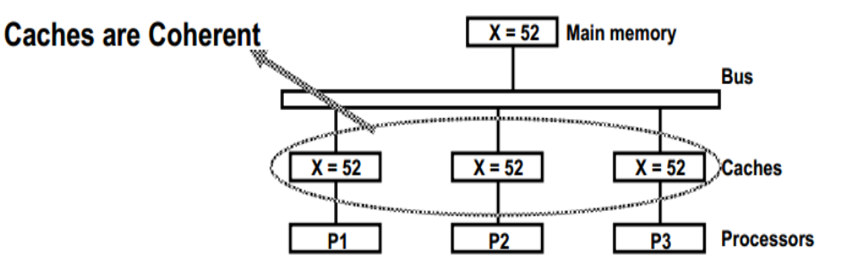
Contd..

Slide 31
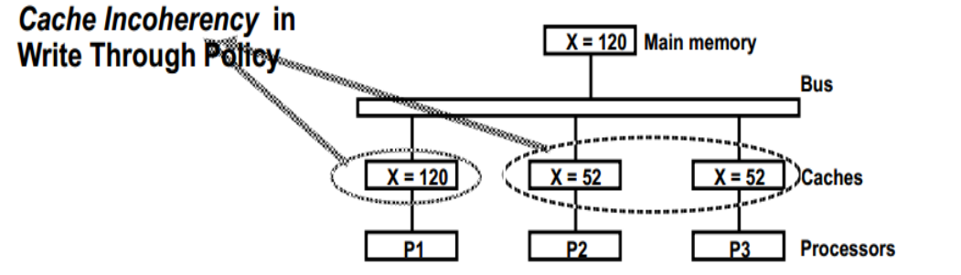
Contd..

Slide 32
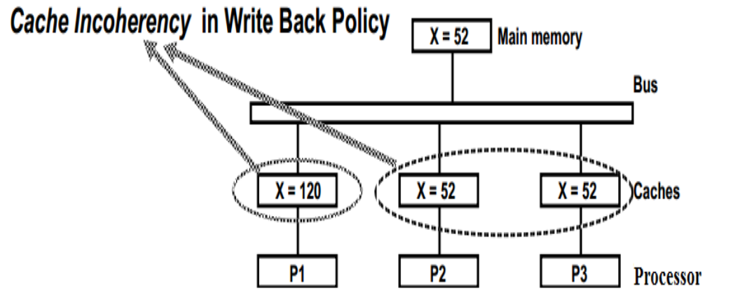
Contd..

